Slide 1

Carbon Credits – dodgy offsets or the real deal?
Ric Brazzale, July 2022
Lighter Footprints

Slide 2
Key points
Voluntary action is important and can make a material contribution to reducing Australia’s emissions
Commitment to renewable energy is an important part of voluntary action and needs to augment government action and targets – not replace them
Carbon prices have risen significantly over the last few years reflecting increasing community concern and ambition – most carbon offsets surrendered have been cheap international units
Changes are required to make offsets effective and meaningful
Some example of Carbon Reduction Projects

Slide 3


What do we do?
We seek to dramatically reduce greenhouse emissions through supporting our clients successfully roll out clean energy solutions (solar, wind, energy saving upgrades, batteries etc …)
We do this by monetising the benefits that these technologies deliver in reducing greenhouse emissions (supported by government schemes)
  We originate ACCUs, Renewable Energy Certificates and Energy Efficiency Certificates
  In business since 2007 - Offices in Sydney & Melb
www.greenenergytrading.com.au
www.nationalcarbonbank.com.au
www.greenmarkets.com.au
Notes:
www

Slide 4
Diverse range of Carbon/Offset schemes currently operating in Australia
Certificate / Market | Liability | Metric / Price | Time Frame | Size and direction
STCs – Small scale renewables (solar) | Electricity Users | MWh /$40 | Phases out by 2030 | 50m/a -Declining as deeming reduces
LGCs – large scale renewables (>100kW) | Electricity Users | MWh / $50 | 2030 | 33m/a – Target met
VEECs – Vic, Energy Savings eg. LED lighting | Energy Users | Tonnes / $71 | 2030 | 6.7 mt/a – gas savings important
ESCs – NSW, Energy Savings eg LED Lighting | Electricity Users | MWh / $33 | 2050 | 13% of liable energy use by 2030
NSW – Renewable Fuels | Gas Users | GJ (not yet operating) | 2044 | 8 PJ of Green Hydrogen by 2030
ACCUs – National Safeguard / ERF | Large Emitters | Tonnes / $29 | No limit | ALP – 5mt/a pa reduction in baselines
Range of schemes, different metrics and different liable entities

Slide 5
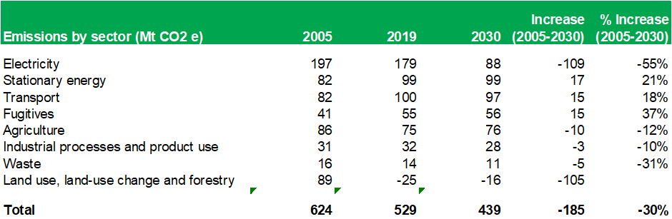
Electricity doing the heavy lifting in reducing emissions
Australian Government Emission projections, October 2021
Electricity emissions falling due to Commonwealth renewables scheme and state energy savings schemes
Reduction in land use emissions supported by ERF and less land clearing
Stationary and fugitive emissions rising due to growth in LNG and Coal production (baselines under Safeguard Mechanism ineffective to date)

Slide 6
How will Government deliver its 43% emission reduction target
Policies to deliver an additional 89 mt reduction by 2030
$20 billion Rewiring the nation – (37 mt/a)
Tightening Safeguard mechanism baselines (48 mt/a)
National Electric Vehicle Strategy (4 mt/a)
The Safeguard mechanism covers 215 facilities that exceed 100,000 tonnes of direct emissions per annum (Scope 1)
In total the facilities accounted for 140 million tonnes of emissions in 2020-21.
Plan is to tighten baselines – so that these facilities need to reduce their emissions (or buy offsets) so that in total they produce 48 mt/a less emissions by 2030
Can produce credits where emissions lower than baseline

Slide 7
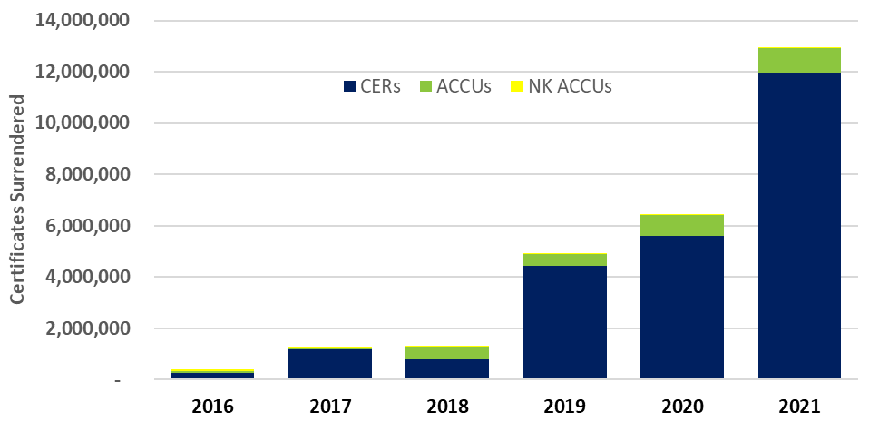
Strong growth in voluntary surrender of Carbon Credits
Market of 15 mt/a of carbon credits in 2021
950,000 ACCUs surrendered in 2021
Source: Australian National Registry of Emission Units (ANREU)
In addition more than 2 million VERRA and Gold Standard units surrendered not captured by the ANREU registry

Slide 8
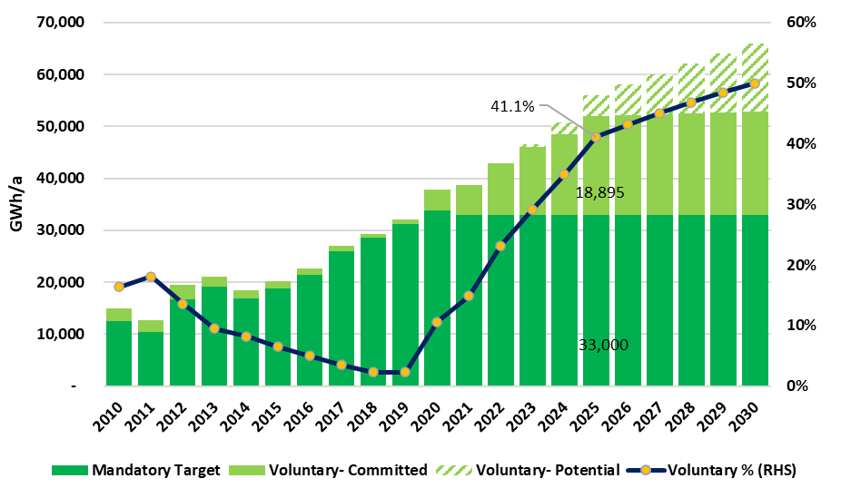
Renewable Certificates (LGCs)
What is the demand?
Voluntary market is significant (41% by 2025)

Slide 9
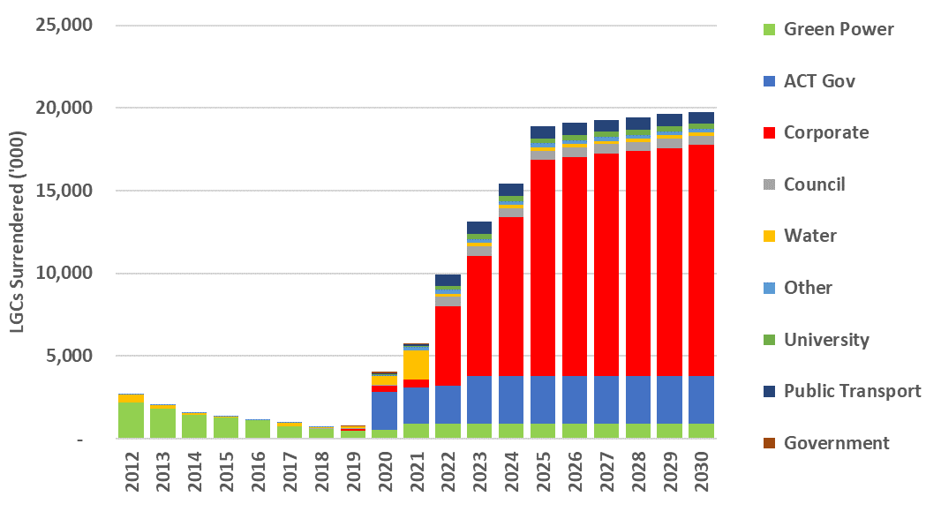
Corporate Voluntary LGC surrender is significant and growing
Includes only credible & specific commitments
Voluntary market of 5.8m in 2021 growing to 18.9m by 2025
Corporate market of 0.4m in 2021 growing to 13.1m by 2025
Includes contracting with new renewables or surrendering LGCs

Slide 10
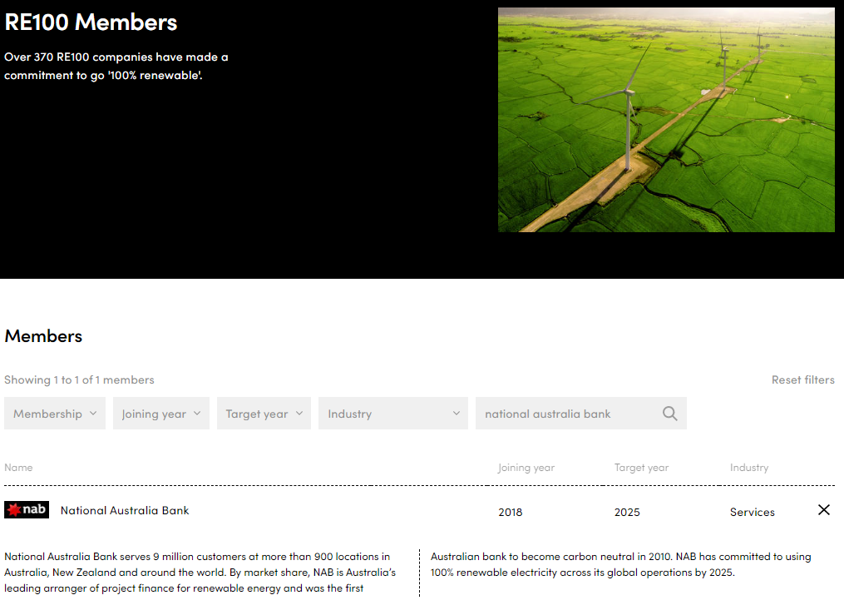
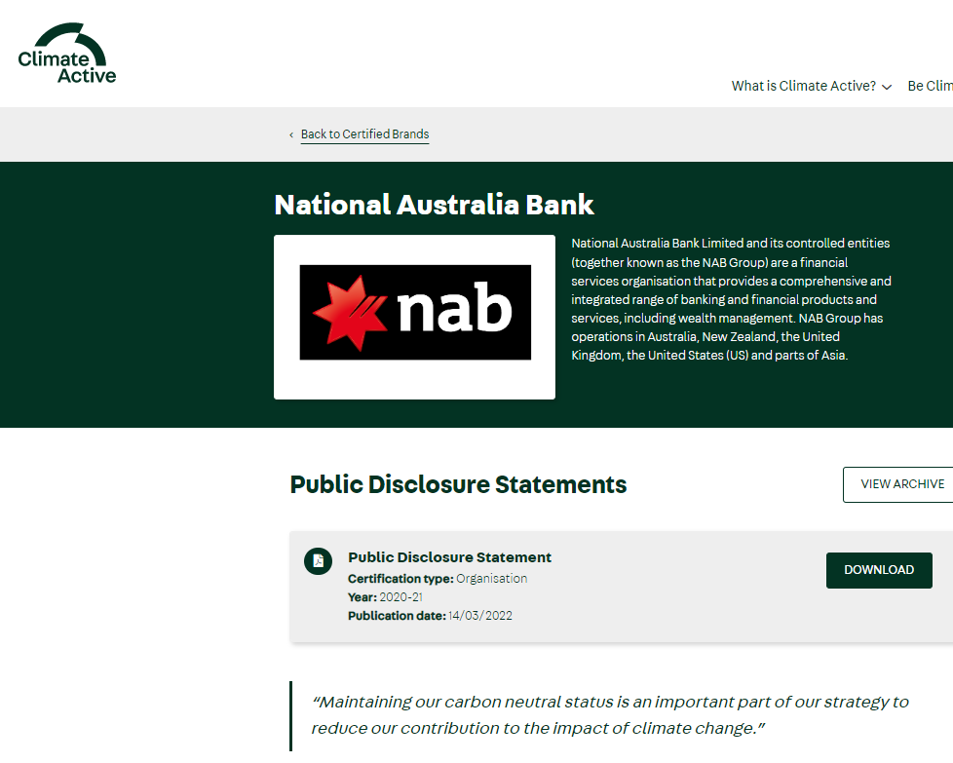
National Australia Bank an example of voluntary action
Carbon Neutral since 2010 (Climate Active)
Member of RE100 – 100% renewables
RE100 – 370 members globally includes
  Woolworths, Westpac, CBA, Apple, Meta, Lego …..
Climate Active has 387 organisations making carbon claims for organisation, product or services

Slide 11
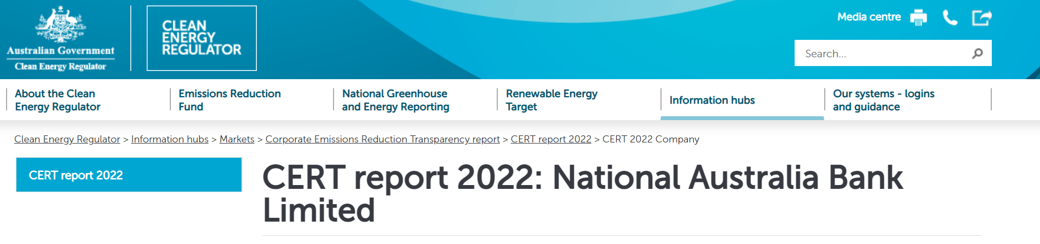
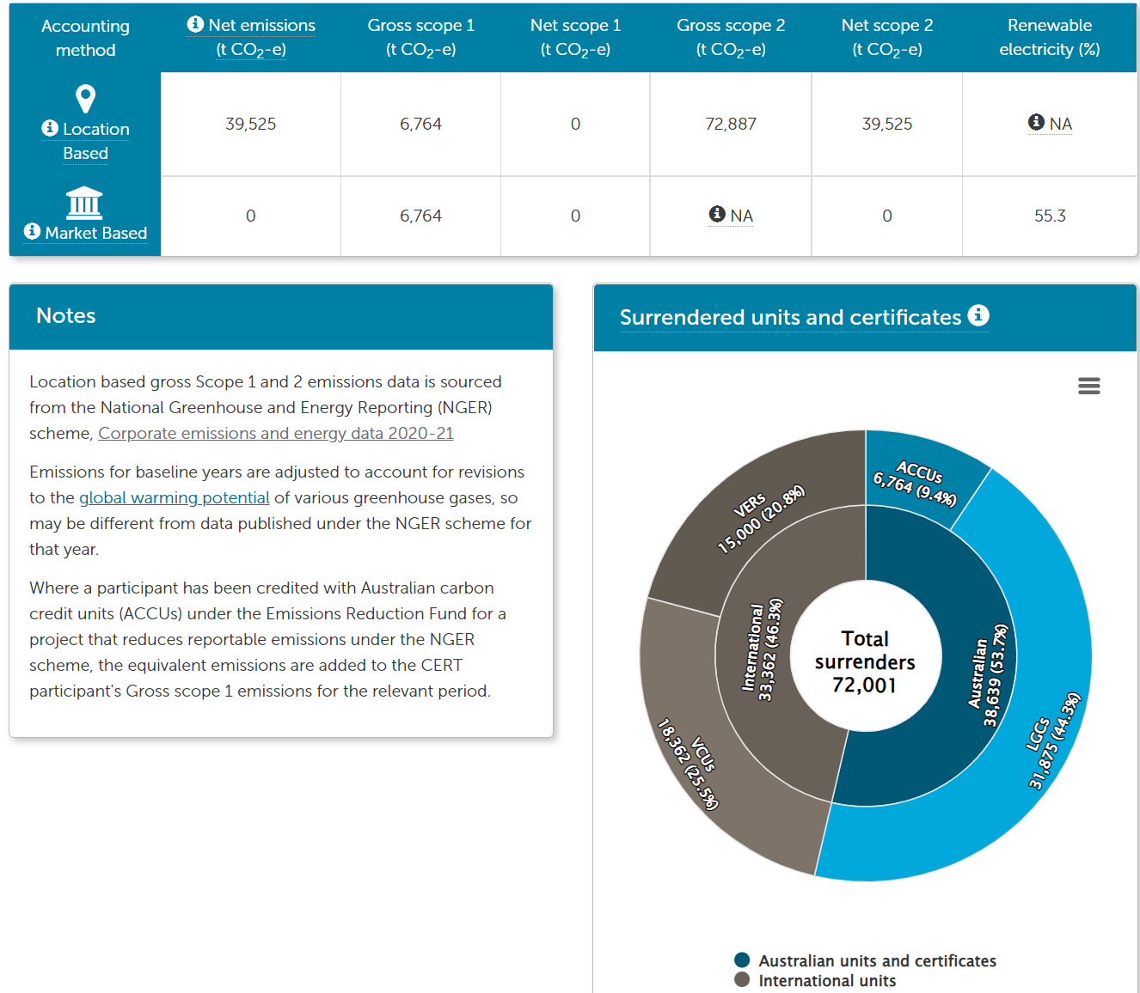
Accountability and transparency is critical
Corporate Emission Reduction Transparency (CERT) initiative
Being developed as a pilot (23 companies)
  Presents a snapshot of climate related commitments
  Reports progress in meeting targets
  Uses a standardised reporting framework
15,000 VERs
18,362 VCUs
6,764 ACCUs
31,875 LGCs

Slide 12
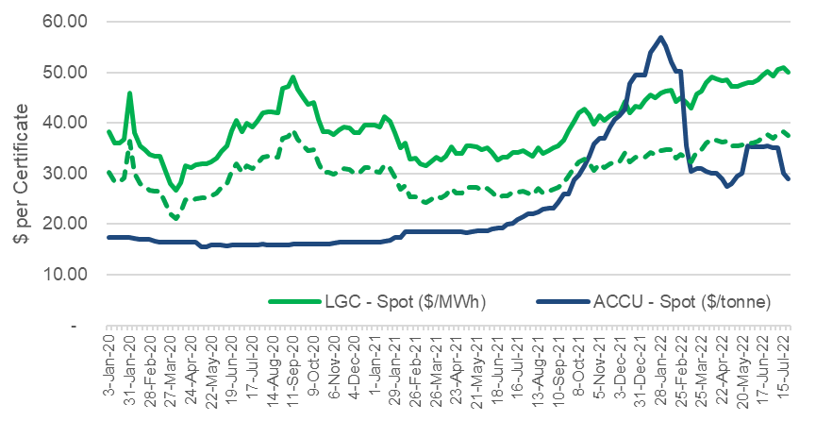
LGC and ACCU prices
Savannah burning and HIR ACCUs attract a premium
International offsets are significantly cheaper ($3-$10/t)

Slide 13
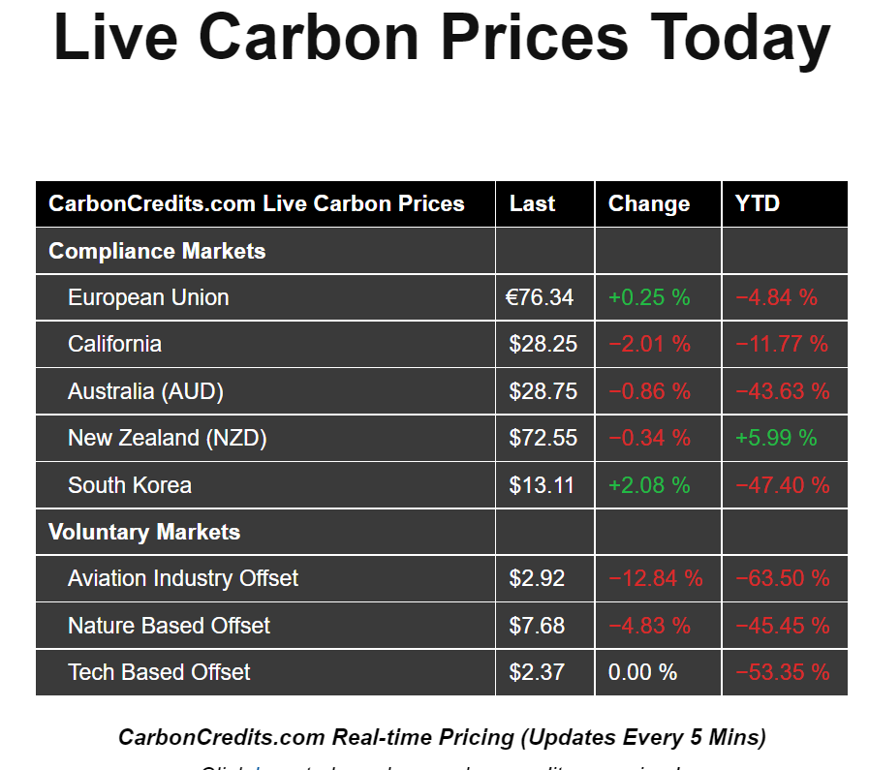
International Carbon prices

Slide 14
Making voluntary action additional
At present most voluntary action appears to have no meaningful consequence.
Simply reduces the requirement for Australia’s largest emitters including the federal government itself, to take action to reduce the impact of their own emitting activities.
This leads to a situation which is both dis-incentivising, economically irrational and unfair.
Voluntary Action should augment compliance measures - not replace them.

Slide 15
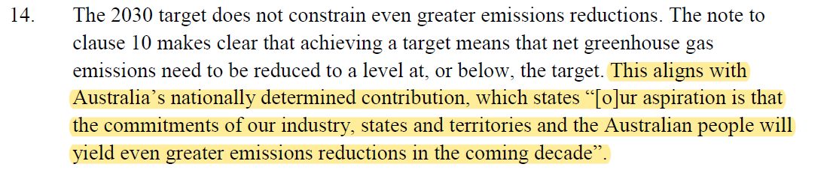
Voluntary to be additional to NDC
In updating its Nationally Determined Contribution (NDC) and tabled legislation the Government has stated that the 43% target was a floor and that its aspiration was that even more emission reductions could be delivered
Voluntary action (surrender of ACCUs and LGCs) could amount to an additional 44Mt/a of emission reductions – get us to beyond 50% reduction by 2030
Make sure that voluntary action does not make it easier for existing polluters – or reduce the emission burden of new fossil fuel projects
Climate Change Bill 2022 - Explanatory Memorandum

Slide 16
What needs to change ….
Voluntary action that results in a surrender of a Carbon Credits (ACCU) or LGCs should result in abatement beyond mandated measures – should not be counted in meeting Nationally Determined Contribution (NDC).
Companies making carbon or renewable commitments to be held accountable for meeting these (participate in CERT)
No double counting of electricity emission reductions - electricity intensity for carbon accounting should net out voluntary surrender of LGCs (someone else is claiming these)
Improve integrity and transparency of offset method development and oversight
Limited use of international offsets eg. Indo Pacific Offsets scheme

Slide 17
Sources of ACCUs

Slide 18

Thank you
Presented by:
Ric Brazzale BComm, MBA
Group Chairman
T 1300 077 784 or 03 9805 0700
ric@greenenergytrading.com.au
greenenergytrading.com.au

