Slide 1
Carbon Offsets: The Problems with the Emissions Reduction Fund Prof Andrew Macintosh The Australian National University

Slide 2
Fundamental rule of carbon offsets
Carbon offsets are a high risk environmental instrument:
Easy to get it wrong and issue low integrity credits because estimating abatement relative to a counterfactual is hard
If credits have low integrity and they are used by polluters to offset emissions, it increases emissions
Consequence = only issue carbon offsets where high confidence they represent real and additional abatement

Slide 3
What went wrong with the ERF?
Majority of credits being issued do not represent real and additional abatement
Proximate cause = bad rules governing project eligibility and abatement estimation (bad methods) + poor interpretation/implementation by Clean Energy Regulator
Root cause = poor governance and a lack of transparency

Slide 4
Proximate Cause – bad methods and bad implementation

Slide 5
The Big Three
ERF dominated by three project types:
Avoided deforestation in western NSW = ~22% of issued ACCUs
HIR = ~27% of issued ACCUs
Landfill gas = ~27% of issued ACCUs
77% of the program comes from the big three
Major integrity problems with all three

Slide 6
Avoided deforestation
Allows landholders in western New South Wales to get ACCUs for not clearing native forests
Based on assumption that landholders who applied for and received a specific type of clearing permit would use them within 15 years
Problem – clearing permits were substantially over-allocated, authorising clearing of substantially more forests than would ever have been cleared, particularly within 15 years
Risk = proponents would get ACCUs for not clearing forests they were never going to clear

Slide 7
What does the evidence suggest? Required increase in historic clearing rate to clear credited forests in 15 years

Slide 8
Human-induced Regeneration (HIR)
Allows landholders to earn ACCUs for regenerating native forests
Originally intended this would occur in areas that were previously cleared – a good idea
Most projects actually set up in semi-arid and arid rangeland areas that have not been comprehensively cleared – a bad idea
Most projects are trying to regenerate native forests in largely uncleared remnant native vegetation, purely by reducing grazing pressure from livestock and feral animals

Slide 9
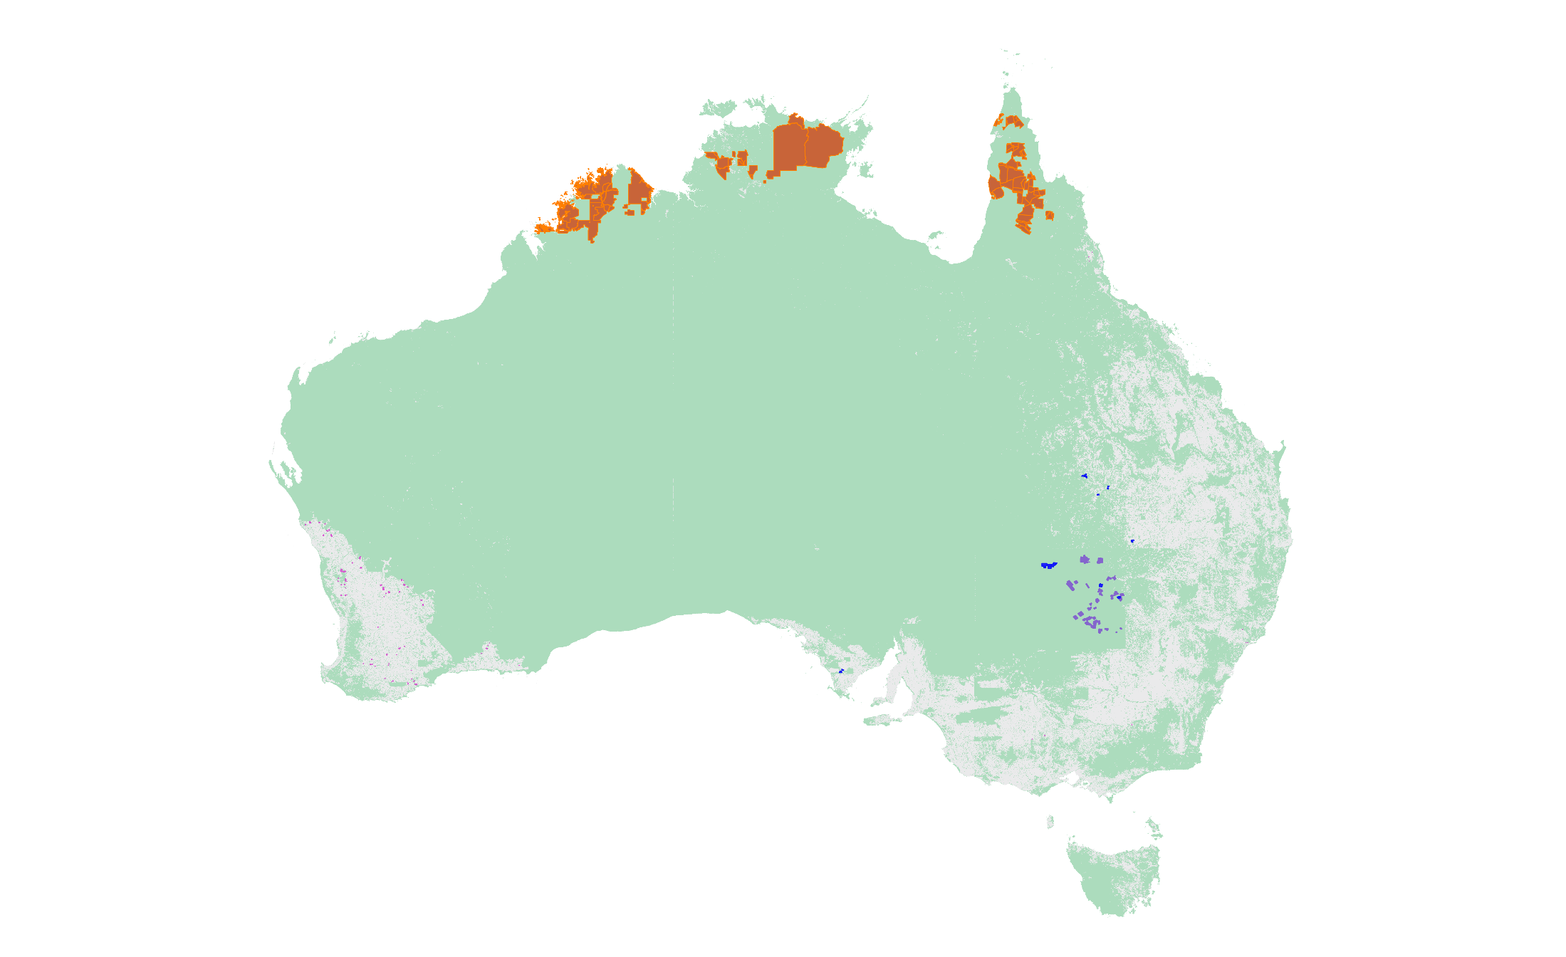
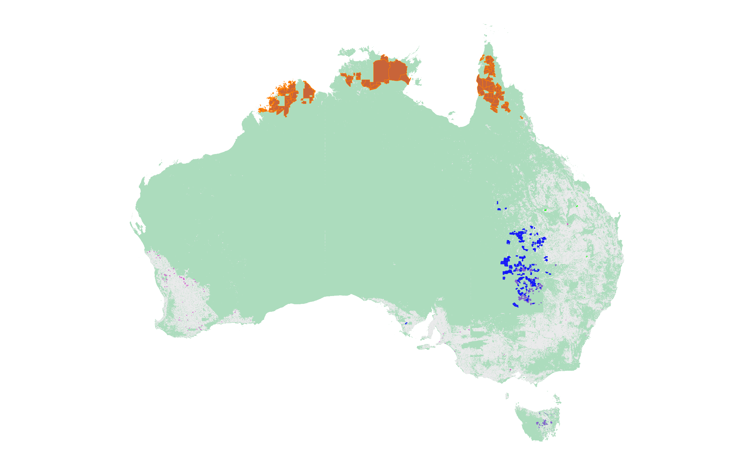
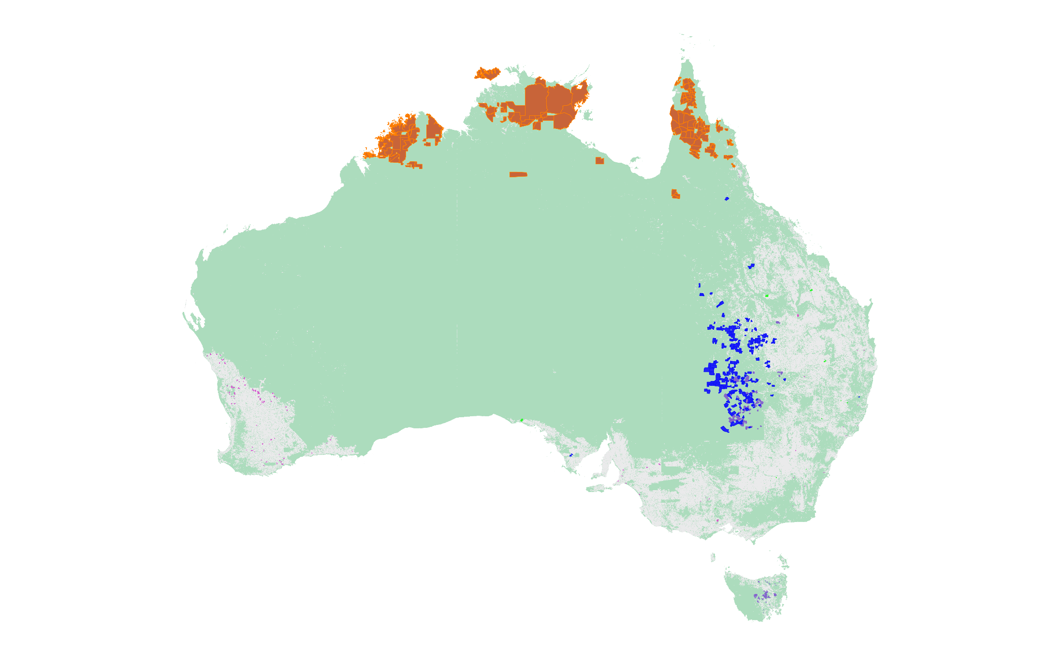
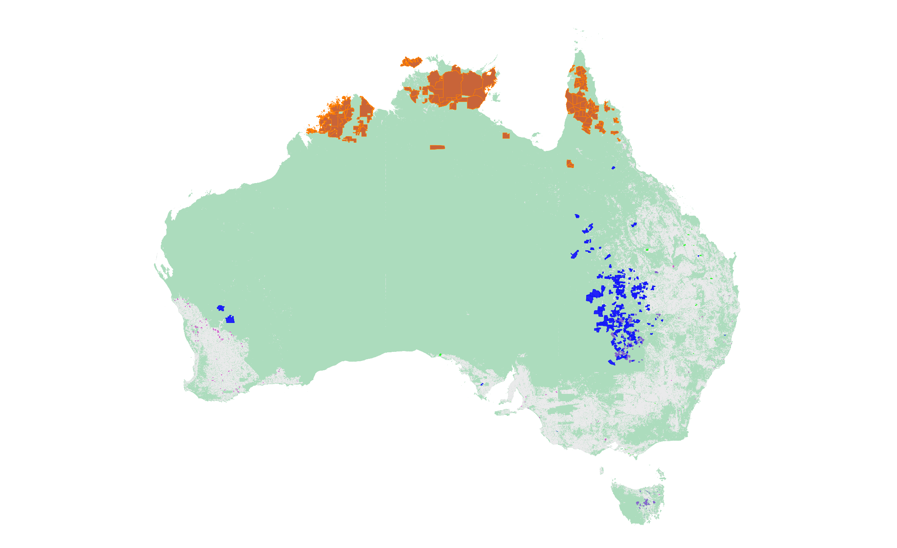
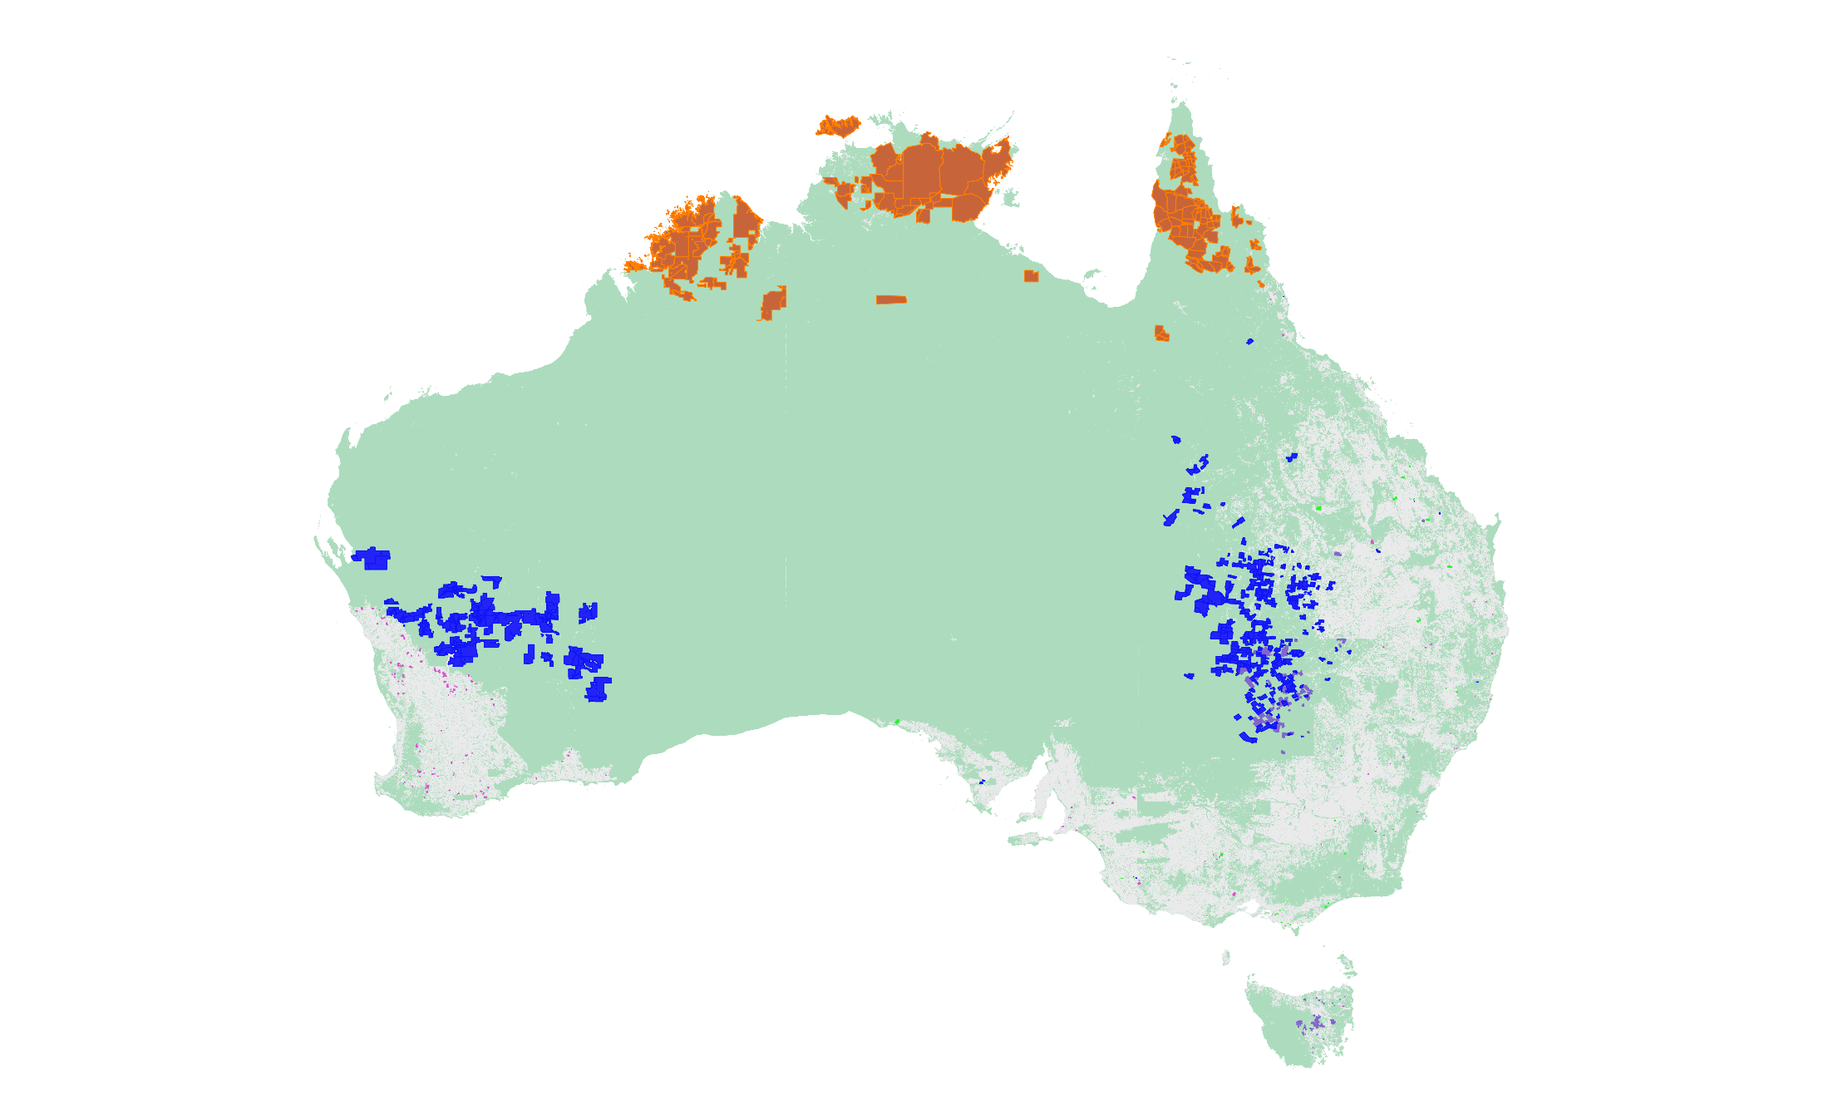
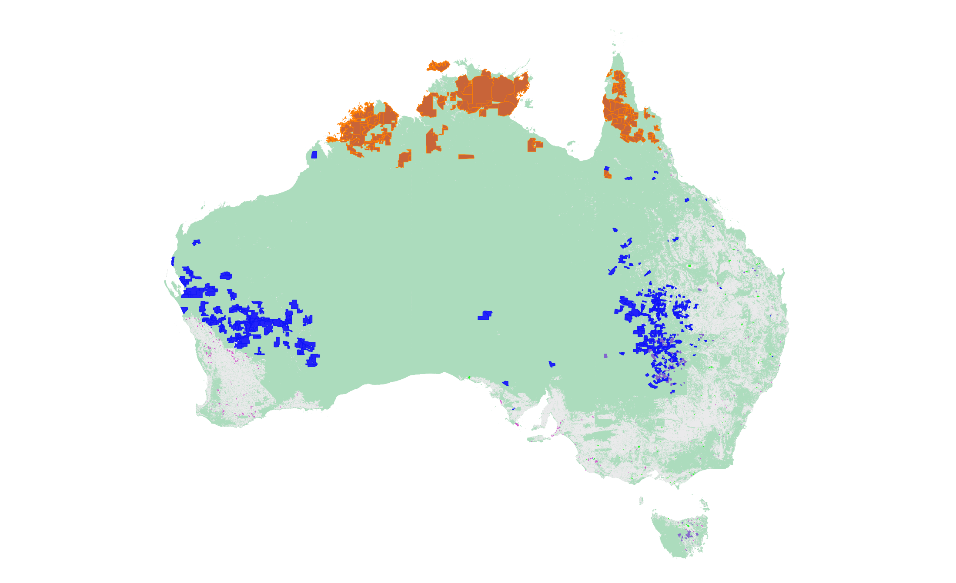
ERF project areas
Native vegetation cover (NVIS)
2013
2019
2021
2020
2015
2016
2017
2014
2018
Native vegetation
Cleared (MVG 25 and 29)
Sources: https://data.gov.au/data/dataset/erf_project_mapping
https://www.awe.gov.au/agriculture-land/land/native-vegetation/national-vegetation-information-system/data-products

Slide 10
Problems with HIR
Two main integrity problems with HIR
Over-crediting: projects are being substantially over-credited because the model used to estimate tree growth assumes the areas have been substantially cleared (or >95% reduction in tree/shrub cover by another means)
Non-additionality: where trees are regrowing, it is mostly due to rainfall, not the reduction in grazing pressure (i.e. it is not additional)

Slide 11
Over-crediting
Area-based model = estimates tree growth (biomass accumulation) in 1 ha of plantings or regenerating native forests
Yr 1 (start): no mature trees/shrubs, biomass <5% of Max
Mid-age: even-aged (uniform) regeneration of trees and shrubs, with age of max growth 10-12.53 yrs
Max: maximum biomass site can contain with native vegetation
E.g. 160 tCO₂ = made up of 16 25mx25m pixels, each with av max of 10 tCO₂

Slide 12
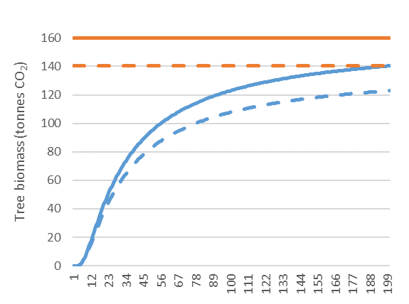
What if there are already mature trees on the site?
Same principle – tree affected areas cover, say, 1,250 m²
Project activity (planting or regeneration of trees) cannot occur successfully in areas affected by mature trees
Valid application of model requires either:
removal of areas with mature trees; or
reduction of max biomass in model
Max biomass: was 160, now 160 – 5 – 5 – 5 – 5 = 140 tCO₂

Slide 13
What is happening?
For Environmental Plantings Method: proponents must exclude areas containing mature trees from credited areas
For HIR: proponents allowed to include areas with mature trees and no changes in model
Result = proponents of HIR projects are receiving ACCUs to grow trees that were already there when the projects started!

Slide 14
HIR additionality
Most projects claiming they are regenerating native forests by reducing grazing pressure
Science suggests grazing has relatively limited impact on tree/shrub cover in rangeland areas
Affects ground cover and biodiversity but limited impact on tree/shrub cover
Certainly extremely rare (if not impossible) for grazing to reduce woody biomass by >95% over significant areas
Rain-drought cycle is the primary driver of tree/shrub cover changes

Slide 15
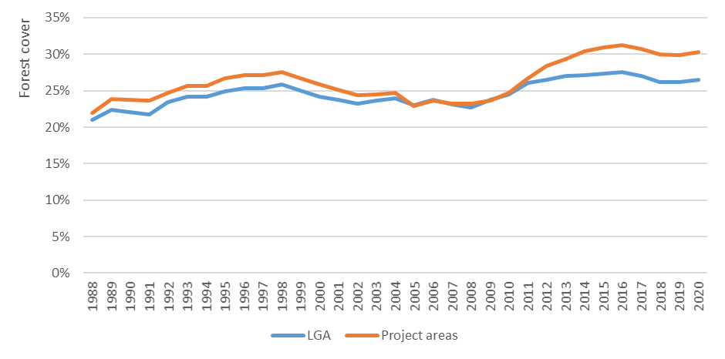
Bourke (NSW)
Projects start

Slide 16
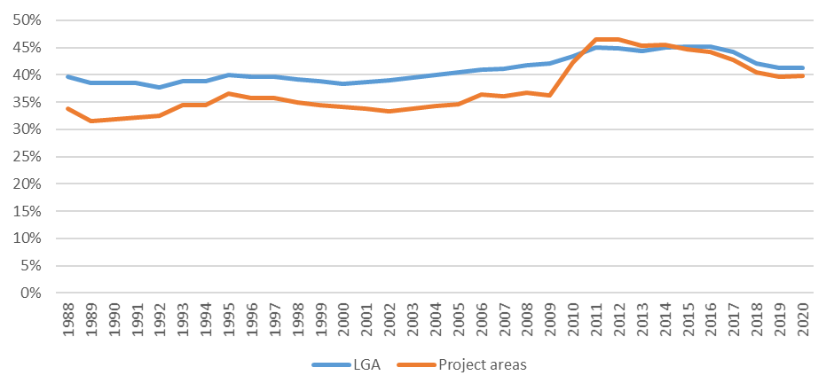
Cobar (NSW)
Projects start

Slide 17
Root Cause – bad governance and a lack of transparency

Slide 18
Carbon offset markets are ‘special’
Normal market: buyer cares about quality, and sellers differentiate on basis of quality – means there is incentives to maintain quality
Carbon market: most buyers do not care about quality, sellers generally do not care about quality – means elevated importance of rule makers & regulators as guardians of integrity
Role of rule makers & regulators made more important by complexity – very hard for 3rd parties to evaluate and track integrity of offsets
Result = need strict separation of powers, radical transparency and processes to involve 3rd parties

Slide 19
ERF governance structures
Strict separation of powers/roles: NO
Clean Energy Regulation is the Rule maker, Regulator and Government buyer, and it staffs the Rule assessor
Transparency: NO
Location of projects is published but not credited areas
Offset reports – not published
Audit reports – not published
Abatement estimation assumptions – not published
3rd party involvement: NO
3rd parties given limited or no access to rule making
No third party appeals

Slide 20
Conclusion
ERF is broken – bad rules, bad implementation and bad governance
New Government needs to intervene to ensure the ERF has integrity
The transition to integrity is going to be rough – vested interests are going to pay a price
There is a need for a price cap in the Safeguard Mechanism to shield polluters from the impacts of the transition to integrity

